Slide 1
Document Quality Assurance and Validation Procedures
Shashank Shukla

Slide 2
AGENDA
Introduction
Overview of Document Validation
Importance of Ensuring Document Quality
Document ID Check
Validating Document Identification
Counting Valid vs. Invalid IDs
Doc_Type Validation
Checking Document Types
Ensuring Valid Document Types
External Link Validation
Verifying External Links
Ensuring Proper URL Format and Accessibility
Entities Validation
Validating Entities Field
Counting Documents with Entities
Source Platform Validation
Verifying Source Platforms
Ensuring Compatibility with Approved Platforms
Timestamp Check
Validating Timestamp Format
Ensuring Correct Time Representation
Is_Public Validation
Checking for Boolean Values
Title Case Check
Ensuring Proper Casing in Titles
Spam Document Detection
Implementing Spam and Low-Quality Document Checks
Conclusion
Summary of Validation Procedures
Importance of Quality Assurance
Q&A
Addressing Audience Questions
Null Value percentage
Null Values by Column
Null Values by Document Type
Title and Content Validation
Validating Title and Content Fields
Analyzing Token Distribution
Identifying Short or Invalid Titles/Content

Slide 3
INTRODUCTION
In this presentation, we will delve into the meticulous process of data validation and anomaly detection. With a dataset comprising approximately 2 million records, our objective is to ensure data accuracy and integrity before feeding it to the Vespa. We'll explore various validation checks and methodologies, shedding light on key insights and findings. Join us on this journey as we unravel the intricacies of data quality assurance and anomaly identification.

Slide 4
Percentage of Null Values for Each Column
Column | Null Value percentage
attachments | 98.53
entities | 96.80
thread_id | 95.80
title | 95.80
parent_doc_id | 82.39
user_roles | 33.30
user_avatar | 17.75
content | 1.04
user_display_name | 0.05
doc_type | 0.05
external_link | 0.05
channel_name | 0.05
community_name | 0.05
user_id | 0.05
user_other_name | 0.002
user_name | 0.002
channel_id | 0.000051

Slide 5
Percentage of Null Values by Document Type
doctype | username | content | user avatar | user roles | Parent Doc Id | Attachments | title | thread_id | entities
forum | 0.02 | 3.68 | 51.48 | 81.35 | 8.19 | 99.20 | 81.57 | 81.57 | 82.05
news | 0.00 | 0.07 | 0.03 | 21.51 | 95.31 | 90.16 | 98.98 | 98.98 | 100.00
public thread | 0.00 | 1.73 | 100.00 | 100.00 | 0.99 | 100.00 | 98.88 | 98.88 | 99.38
stage voice | 0.00 | 1.11 | 0.00 | 10.00 | 100.00 | 100.00 | 100.00 | 100.00 | 100.00
text | 0.00 | 0.48 | 10.44 | 22.84 | 98.50 | 98.41 | 98.89 | 98.89 | 100.00
voice | 0.00 | 0.40 | 0.00 | 4.53 | 100.00 | 98.80 | 100.00 | 100.00 | 100.00

Slide 6
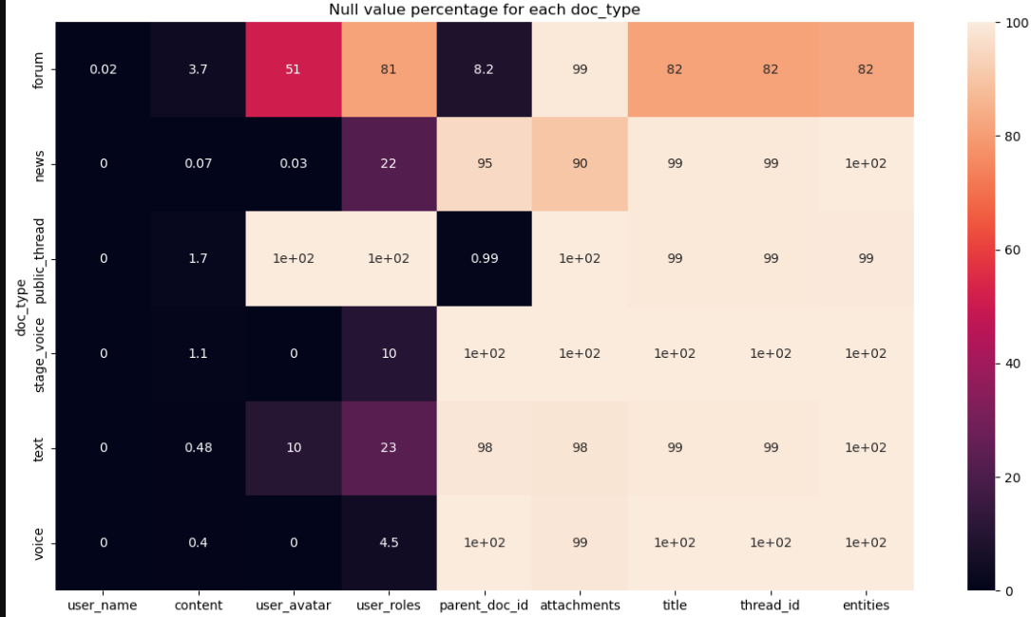
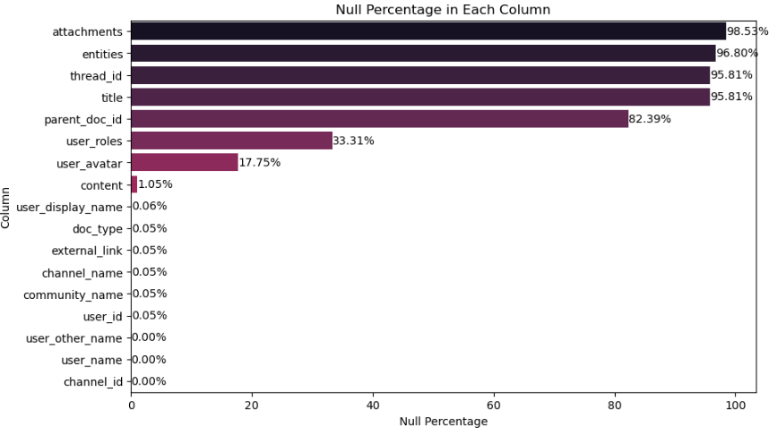
Visual representation of Null values
Document Type
Column Wise

Slide 7
Document ID Validation
Total Documents
19,67,974
Documents with Valid ids
19,67,974
Documents with invalid ids
0

Slide 8
Document Type Validation
Set Of Valid Document Types
News
stage voice
voice
Forum
public thread
text

Slide 9
Doc type percentage distribution

Slide 10
Entities validation
In this column 96.80% of values are Null
The total Invalid Entities is 97.87%
Total Valid Entities are 3.2%

Slide 11
Source Platform Validation
Discord
Valid Platform 100%
Invalid 0%
There is only 1 Platform Type Discord

Slide 12
Timestamp Validation
In this specific field, there are no null values.
01
In this validation, we have ensured that the dates in both the "created_at" and "created_at_str"
fields match and that the dates are not greater than today's date.
02
The total number of documents is 1,967,974, and all of them are considered valid.
03

Slide 13
is public Validation
Total document
19,67,974
True
626
False
19,67,348

Slide 14
the distribution of the "Is Public" attribute based on document type?

Slide 15
Title Case Validation
Total Document
19,67,974
Valid Title
2.47%
Invalid Title
97.57%

Slide 16
Spam document detection Content
Total Document
19,67,974
Valid Title count
13,09,995 (67%)
Invalid Tile count
6,57,979 (33%)

Slide 17
Spam document detection Title
Total Document
82470 (non-null)
Valid Title count
67365 (81%)
Invalid Tile count
15105 (19%)

Slide 18
Title and Content Validation
Missing or Empty Values
Title Missing or Empty: 1,885,504(95.81%) documents
Title Less Than 3 Tokens
Title non-null values: 82,470
1 token: 14,148 (17%) documents
2 tokens: 11,793(14%) documents
Has Only Numbers
Title Has Only Numbers: 5 documents
Content Missing or Empty: 20,602(1.05%) documents
Content
1 token: 555,182(28%) documents
2 tokens: 255,502(13%) documents
Content Has Only Numbers: 108 documents
Has Only Special Characters
Title Has Only Special Characters: 158 documents
Content Has Only Special Characters: 992 documents

Slide 19
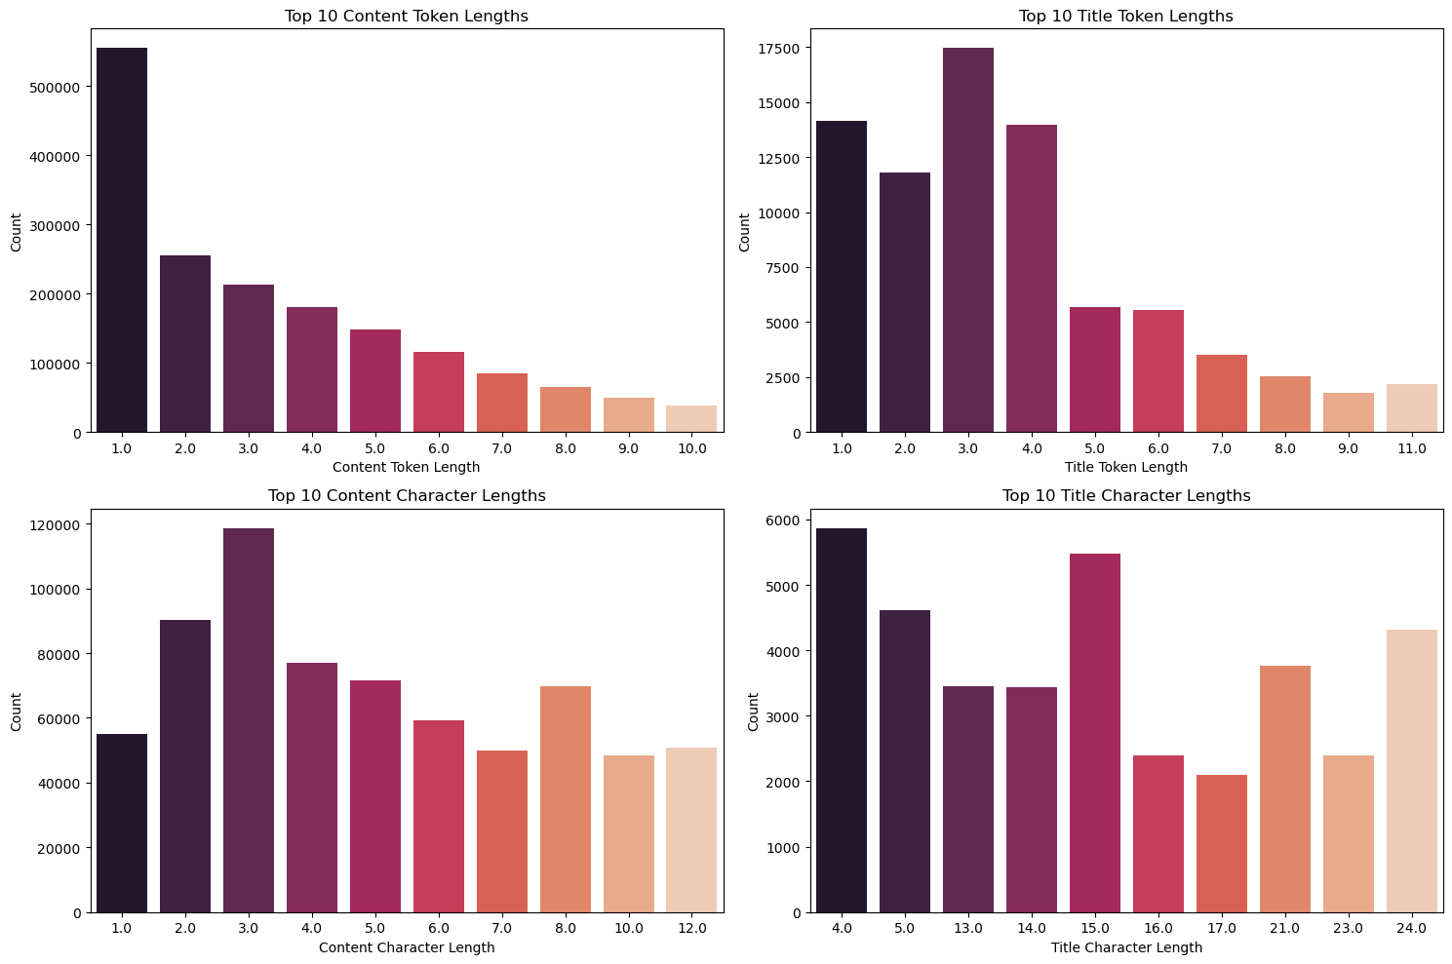
Top 10 Tokens and Character Length

Slide 20
SUMMARY
Null Value Analysis
We observed varying degrees of null values across different columns, with some columns having a high null percentage. For instance, 'attachments,' 'entities,' and 'thread_id' columns have null percentages exceeding 95%.
Document Type Distribution
The dataset contains a variety of document types. Most prevalent are 'text' and 'forum' types, accounting for 81.92% and 17.80% of the dataset, respectively. There is also a small percentage of 'news,' 'voice,' 'public_thread,' and 'stage_voice' document types.
Document Validation
We validated documents based on their document type, identifying discrepancies in null value percentages among different types. Notably, 'forum' and 'news' types exhibit significantly different null value patterns.
Entity Analysis
A portion of the documents (3.2%) contains valid entities. Additionally, 2.13% of the documents have at least two entities, while the majority (97.87%) do not contain any entities.
Platform and Timestamp Validation
All documents have valid source platforms and timestamps, ensuring data integrity.
Is Public Attribute
The 'is_public' attribute has a true value for 626 documents, indicating public accessibility, while 1,967,348 documents have a false value, indicating non-public content.
Title and Content Quality
The dataset has 2.47% of documents with valid titles, while the majority (97.53%) have missing or inadequate titles. Additionally, some documents have content with fewer than three tokens, and a few contain titles or content with numbers or special characters.
Spam Detection
Among the documents, 657,979 are identified as potential spam.
In our comprehensive data analysis, we have identified and examined several critical aspects of the dataset, which is comprised of a total of 1,967,974 documents. Here are the key findings and insights:

Slide 21
THANK YOU
Shashank Shukla
shashanks.ven@splore.com

